Slide 1
Title: Data and Uncertainty Driven Optimization for Dynamic Edge Computing
Name: Athanasios Moustakas
Supervisor: Dr. Konstantinos Kolomvatsos
Department: University of Thessaly, Department of Informatics and Telecommunications
Date: 01/09/2025

Slide 2
Setting the Context
Internet of Things (IoT): Billions of devices generating distributed, volatile, and heterogeneous data
Edge Computing (EC): Processing data close to data sources to reduce latency and bandwidth
Cluster Computing (CC): Coordinated execution on multiple connected resources
Pervasive Computing (PC): Embedding computation into everyday environments
Need: Distributed frameworks that can adapt to the scale, diversity, and dynamics of these environments

Slide 3
Challenges in Edge Computing
Resource scarcity: Constrained CPUs, memory, and energy in edge devices
Heterogeneous data: Highly localized and non-IID distributions
Unreliable connectivity: Devices can disconnect or fluctuate in availability
Reuse difficulty: Models trained on one node often cannot be reused on others due to differing data distributions and local contexts
Need for adaptability: Systems must respond to context shifts in real-time

Slide 4
Research Gaps
Insufficient reuse logic: No structured mechanism for data similarity exploitation
Neglected data adaptation: Training does not monitor dynamic dataset properties
Overlooked uncertainty in TL: Lack of mechanisms to handle dynamic distributions and variability
Lack of drift awareness: Changes in data over time not detected or addressed
Oversight of correlations: Task similarities underutilized in scheduling

Slide 5
Problem Statement
How can we design data and uncertainty-driven frameworks that:
Operate efficiently under IoT/edge/cluster/pervasive constraints, enabling scalable and context-aware distributed intelligence
Adapt to limited resources and dynamically changing workloads at the edge
Ensure robust decision-making by integrating uncertainty estimation into knowledge transfer and scheduling
Support continuous learning despite evolving data distributions
Enable efficient reuse of existing knowledge through data related task similarity exploitation

Slide 6
Thesis Contributions (Overview)
Similarity-based dataset clustering
Incremental training framework
Uncertainty-driven transfer learning model
Drift-aware task management framework
Correlation-aware task scheduling

Slide 7
General Setting
N edge nodes exchange data and collaborate directly
Each holds a local dataset with multivariate vectors, reflecting features like CO₂, occupancy, ventilation, etc.
Nodes use statistical/ML models to support predictions or trigger actions
Operate under resource constraints and partial observability
Goal: Build frameworks for effective data processing, task coordination, and learning in edge/cluster computing environments

Slide 8
Dataset Similarity

Slide 9
Introduction
Distributed IoT and Edge systems:
  Data spread across many nodes
  Each node posseses only partial, often biased local data
Impact on ML and analytics:
  Hard to get reliable insights from isolated data
  Broader context needed for accurate predictions and decisions
  Simultaneous processing, knowledge sharing and redundancy reduction
Motivation:
  Understand relationships among datasets across nodes
  Set the stage for smarter, cooperative processing
  Similarity helps avoid excessive training and enables TL

Slide 10
Related Work
Existing work:
  L1/L2 norms (ERP, DTW), clustering, transformations (DFT, DWT)
  Synopsis exchanges (sketches, histograms)
Gaps identified:
  Often rely on static datasets, ignore temporal evolution and multi-dimensional
  correlations
  Do not investigate trade-offs between detection accuracy and resource constraints
  Most methods require full dataset access, impractical for edge
  (limited CPU, bandwidth, privacy)

Slide 11
Problem Statement
Goal:
  Determine dataset similarity across nodes using a lightweight, privacy-preserving way
  A synopsis is a summarizing representation of a dataset (e.g. mean/std for every
  feature)
Method:
  Each node builds a synopsis vector (mean/std), S =(s1,s2,…,sl)
  Want to decide if two nodes’ datasets are similar enough to enable collaborative
  processing
Objectives:
  Handle time-evolving datasets through multi-dimensional metrics
  Balance accuracy vs. communication and computation cost

Slide 12

Methodology
.
  Synopsis representation:
    $S=\left(s_{1},s_{2},…,s_{l}\right), s_{i}∈\{μ_{i},σ_{i}\}$
    Sliding time window: $T=\left[1,…,w\right]$, (time series)
  Correlation analysis:
    $CORR_{i}\left(Sl_{i},Sp_{i}\right)=\frac{\sum_{j=1}^{w}{\left(Sl_{i}\left[j\right]−MSl_{i}\right)⋅\left(Sp_{i}\left[j\right]−MSp_{i}\right)}}{\sqrt{\sum_{j=1}^{w}{{\left(Sl_{i}\left[j\right]−MSl_{i}\right)}^{2}}}⋅\sqrt{\sum_{j=1}^{w}{{\left(Sp_{i}\left[j\right]−MSp_{i}\right)}^{2}}}}$
    $MSl_{i}=\frac{\sum_{j=1}^{w}{Sl_{i}\left[j\right]}}{w},MSp_{i}=\frac{\sum_{j=1}^{w}{Sp_{i}\left[j\right]}}{w}$
  Probabilistic distance:
    $dist\left(Sl_{i},Sp_{i}\right)=|Sl_{i}−Sp_{i}|=\sum_{j=1}^{w}{|\left(Sl_{i}\left[j\right]−Sp_{i}\left[j\right]\right)|}$
  Chebyshev’s inequality:
    $P\left(|dist\left(S_{l_{i}},S_{p_{i}}\right)−μ | ≤ kσ \right)≥1−\frac{1}{k^{2}}=\frac{k^{2}−1}{k^{2}}$

Slide 13

Methodology
Thersholds:
  Correlation: θ
  Probability: ρ
  Distance: β
Similarity condition:
  $CORR_{i}\left(Sl_{i},Sp_{i}\right) ≥θ \text{and} k⋅σ+μ≤β and \frac{k^{2}−1}{k^{2}}≥ρ$

Slide 14
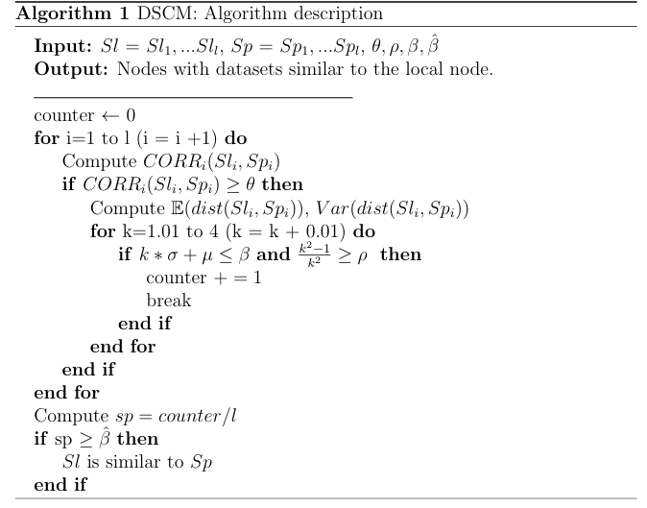
System Architecture / Algorithm

Slide 15
Experimental Setup
Datasets:
  D1: fan vibration data (5d, real-world)
  D2: air quality sensor data (15d, real-world)
  D3: industry data (14d, synthetic)
Compared with:
  Dynamic Time Warping (DTW) (baseline)
  Measures distance between two time series by aligning them in time
Metrics Used:
  MSE: Measures accuracy of similar peer detection (ideal: 0)
  F-score: Combines precision and recall (ideal: 1)
  MAPE: Evaluates prediction accuracy in percentage terms (ideal: 0%)
Tested:
  Mean/Std synopses

Slide 16
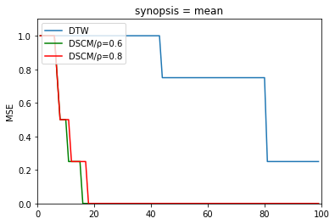
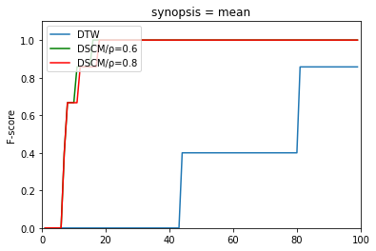
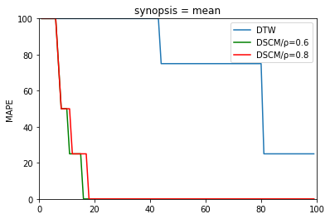
Results
Performance metrics of MSE, F-Score and MAPE (Dataset D1 Synopses = Mean)

Slide 17
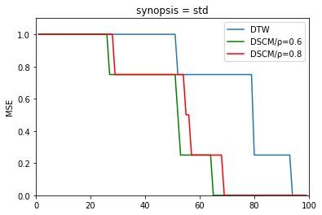
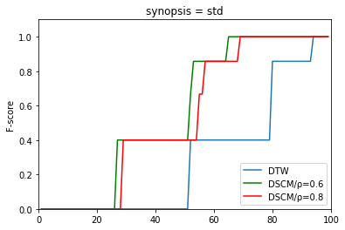
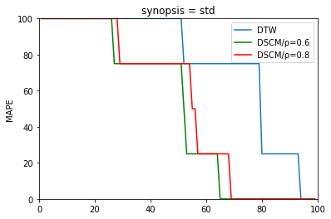
Results
Performance metrics of MSE, F-Score and MAPE (Dataset D1 Synopses = Standard Deviation)

Slide 18
Results
Mean synopses:
  DSCM: MSE = 0, F-score = 1, MAPE = 0% at t=17 (ρ=0.6) / t=18 (ρ=0.8)
  DTW: MSE = 0.25, F-score = 0.85, MAPE = 25%, at t=80
Std synopses:
  DSCM: MSE=0, F=1, MAPE=0% at t=65 (ρ=0.6) / t=69 (ρ=0.8)
  DTW: Same values at t=94
Observations:
  Similar performance for both thresholds (ρ=0.6, ρ=0.8)
  Mean synopses detect similarity faster than std synopses
  DSCM retrieves all similar nodes faster and more precisely than DTW

Slide 19
Discussion
Contributions:
  A novel combined correlation + probabilistic distance approach for
  dynamic dataset similarity detection
  Reduces communication load (synopses vs. raw data)
  Enables scalable similarity detection across nodes
Future work:
  Incorporate more complex data structures for synopses (e.g., histograms, sketches)
  Adaptively tune thresholds

Slide 20
Incremental Training

Slide 21
Introduction
Real-time analytics on IoT and Edge:
  Rely heavily on ML/DL models to detect patterns, forecast, make decisions
  ML/DL training resource-intensive in edge environments
  Slow training delays deployment of intelligent services,
  increases costs and hinders rapid adaptation to new data
Μotivation:
  Find a way to accelerate training, so edge nodes can quickly adapt
  Minimize ML/DL model training resource requirements
  Models trained without cloud offloading keeping data local, latency low,
  and privacy

Slide 22
Related Work
Existing work:
  Internal model tweaks (batch normalization, dropout, selective backpropagation)
  Importance sampling, instance pruning
Gaps identified:
  Existing methods do not adaptively monitor data context during training
  Past methods do not address the distributional divergence of data assets
  throughout the training process
  Existing approaches neglect dynamic dataset properties and waste resources on
  redundant samples

Slide 23
Problem Statement
Goal:
• Accelerate ML/DL training by dynamically selecting only the most informative samples
• Avoid wasting resources on samples that don’t significantly reduce the model’s performance
Method:
  Training process T operates on dataset split into processed ​ and unprocessed sets
  Want to decide if a sample should be trained on, based on its impact on loss and probability of redundancy
Objectives:
• Handle dynamic data distributions and evolving loss landscapes
• Balance model accuracy vs. training time and resource usage

Slide 24

Methodology
Training data:
  $D_{T} =$processed samples
  $D_{\overline{T}}$ = non-processed samples
Loss:
  $L\left(x,\hat{y},y\right)=\left|\hat{y}−y\right|$
Distribution Divergence (Kullback-Leibler) monitoring:
  $D_{KL}\left(A∥B\right)=\sum_{x∈X}{A\left(x\right)}\ln\left(\frac{A\left(x\right)}{B\left(x\right)}\right)$
Probability-Based Sample Acceptance:
  $p_{x}=\sum_{k=1}^{K}{w_{k}f_{k}\left(x;Θ_{k}\right)}$
  $\hat{Θ}=\arg{\max_{Θ}{\prod_{i=1}^{\left|D_{𝒯}\right|}{f\left({\left\{D_{𝒯}\right\}}_{i};Θ\right)}}}$

Slide 25
Methodology
Clustering-Based Fine-Tuning (Recovery Strategy):
  K-Means
Thersholds:
  Acceptable loss: θw
  Probability: θs
  Divergence: 0.05 (constant)

Slide 26
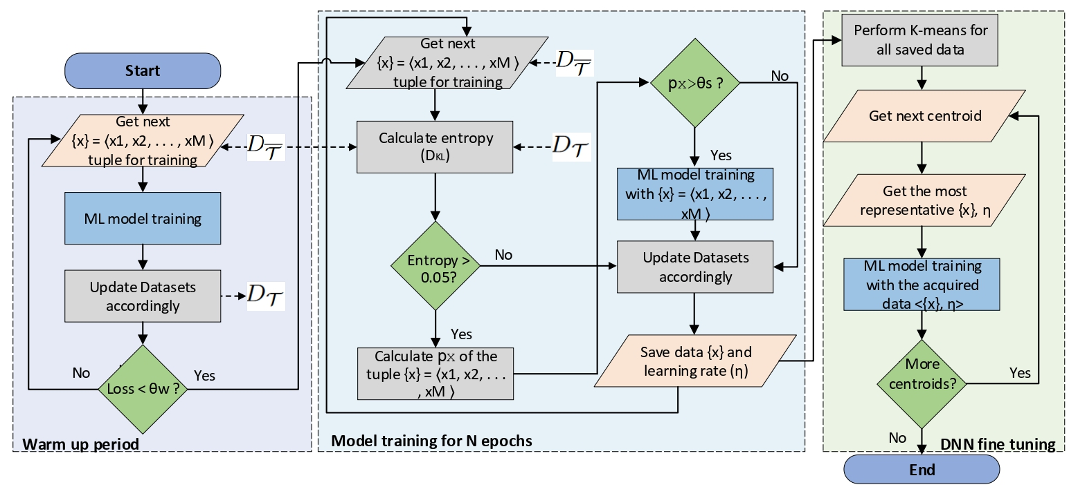
System Architecture / Algorithm

Slide 27
Experimental Setup
Tested on:
• SVM on MNIST (60,000 images, 10 classes)
• DNNs (VGG-19, MobileNetV2, ResNet101, DenseNet121) on CIFAR-10/CIFAR-100
Performance metrics:
• Test accuracy: on held-out data (%)
• Training time: split into warm-up and data-aware phases (min.)
• Drop-off rate: % of training samples skipped
Compared with :
• Compared data-aware method vs. full training (Base) and Random sampling (same drop-off rate but no informed skipping)

Slide 28
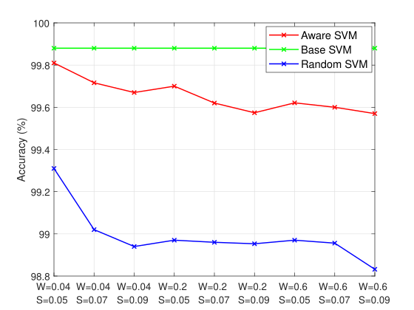
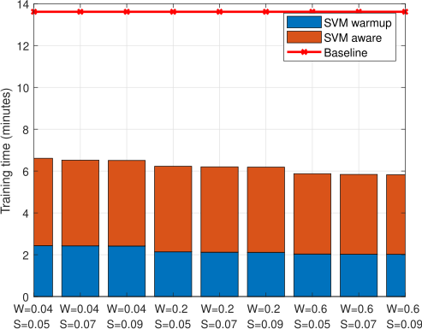
Results
SVM Model test accuracy for the MNIST dataset, over different θw and θs thresholds
SVM model execution time for Base and data-aware implementations

Slide 29
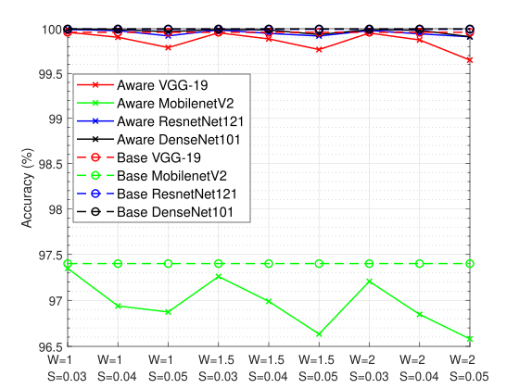
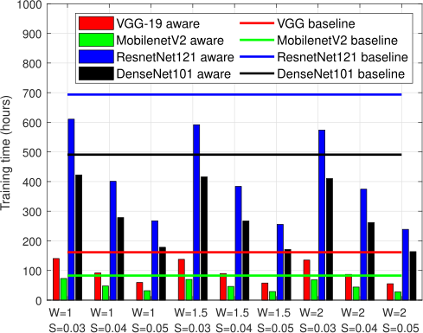
Results
DNN Models accuracy for the CIFAR-10 dataset
DNN models execution time using the
CIFAR-10 dataset

Slide 30
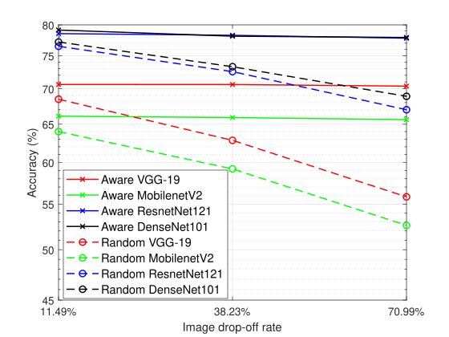
Results
Data-aware methodology accuracy comparison over the Random method for CIFAR-100

Slide 31
Results
SVM (MNIST):
  Accuracy for data-aware ranges between [99,6%-99,8%], while base achieves 99,85% and random drops significantly lower
  0.66% average accuracy loss of the random model relative to the data-aware approach
  2.19x training time speedup over the base method
DNN Models(CIFAR-10):
  Accuracy decrease by only 0.15% on average compared to the base method
  Training time speedup over the base ranges from 1.51x – 2.99x
DNN Models(CIFAR-100):
  Data-aware outperforms random by an average of +6.72% accuracy
  Accuracy gains range from +1.94% up to +14.53%, depending on model and drop-off rate

Slide 32
Discussion
Contributions:
• Developed a data-aware ML training method that dynamically skips low-impact samples
• Reduces computation, speeds up training, yet maintains model quality
• Especially suited for resource-constrained edge nodes, enabling faster deployment of intelligent services
Future work:
• Extend to more data types beyond images
• Tune hyperparameters​ dynamically based on live workload and various resources profiles

Slide 33
Transfer Learning

Slide 34
Introduction
Real-time analytics on IoT and Edge
  Edge devices: limited resources, scarce data
  Need to reuse existing models trained elsewhere
  Heterogeneous data sources and dynamic edge environments
  Potentially unlabeled incoming data-batches
  TL reduces training time and resource consumption
Motivation:
  Need adaptive TL tailored for edge environments
  Minimize reliance on cloud offloading, preserve privacy, reduce latency

Slide 35
Related Work
Existing work
  Homogeneous / heterogeneous TL
  Instance, feature, parameter, relational methods
  Dependance on external datasets with potentially different statistical distributions
Gaps identified
  Static, ignore evolving data
  No uncertainty handling
  Rely on full datasets, costly for edge
  Most TL in edge assumes cloud-origin models and ignores peer-to-peer reuse

Slide 36
Problem Statement
Goal
  Decide when and from where to transfer models
  Need lightweight TL that works under bandwidth and privacy limits
  Use data similarity to guide TL related decisions
Method
  Nodes keep mean and variance vectors (synopses)
  Quantify similarity/dissimilarity with statistical tests
Objectives
  Handle dynamic data distributions
  Minimize retraining and data transfer
  Balance accuracy vs. cost and load

Slide 37

Methodology
Similarity:
  Samples: {$P_{i_{1}},P_{i_{2}},…,P_{i_{M}}\}, \{Q_{i_{1}},Q_{i_{2}},…,Q_{i_{M}}\}$
  Empirical CDF: $F_{M}\left(α\right)=\frac{1}{M}\sum_{i=1}^{M}{I\left(V_{i}≤α\right)}$
  $S_{i,M}=\max_{g}\left|F_{M}^{1}\left(g\right)−F_{M}^{2}\left(g\right)\right|$/$sim\left(P,Q\right)=\frac{\sum_{i=1}^{d}{I\left(S_{i,M}≤β\right)}}{d}$
Dis-similarity:
  $z\left(i\right)=\frac{mp_{i}−mq_{i}}{\sqrt{\frac{vp_{i}}{M}+\frac{vq_{i}}{M}}}$ $/ f\left(i\right)=\frac{vp_{i}}{vq_{i}}$
  $dissim\left(P,Q\right)=\frac{\sum_{i=1}^{d}{I\left(z\left(i\right)>z_{score}∨f\left(i\right)>f_{score}\right)}}{d}$
Thresholds:
  Per dimension similarity: β
  Aggregated similarity: γ
  Dis-similarity: 1-γ

Slide 38
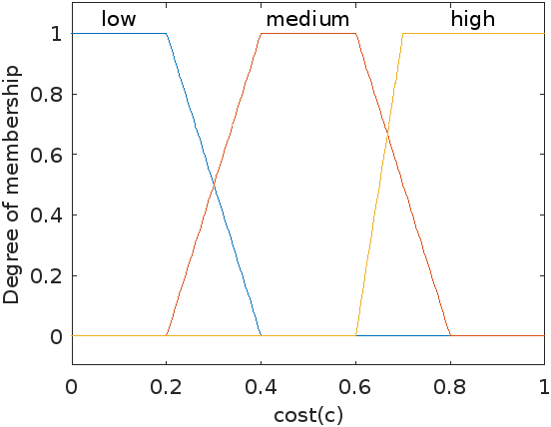
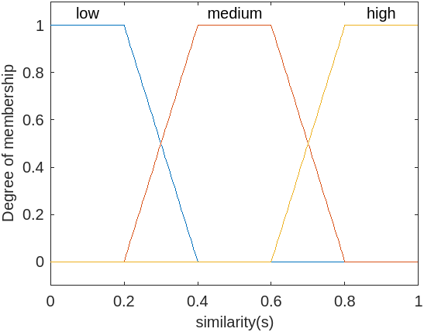
Methodology
Fuzzy decision making:
  DLC (Degree of labeling capability): DLC = fuzzy(cost, similarity)
  DAT (Degree of ability to train): DAT = fuzzy(load, similarity)

Slide 39
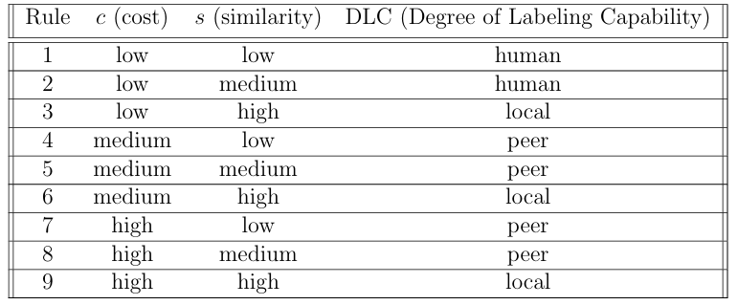
Methodology

Slide 40
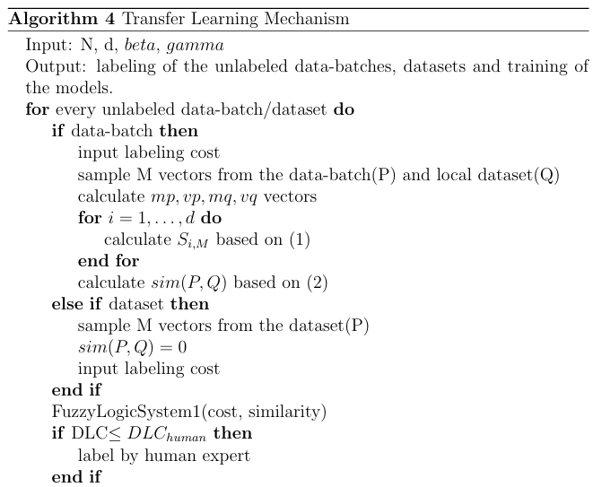
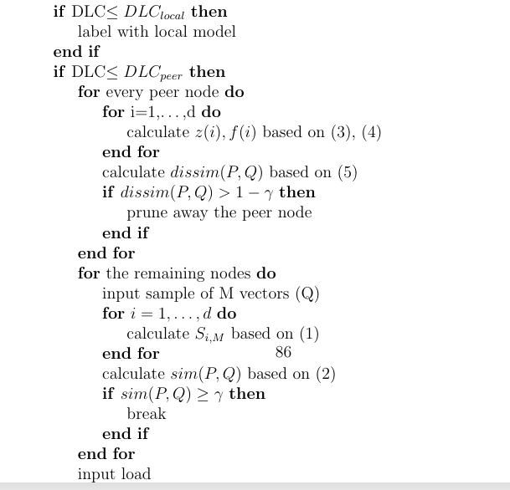
System Architecture / Algorithm

Slide 41
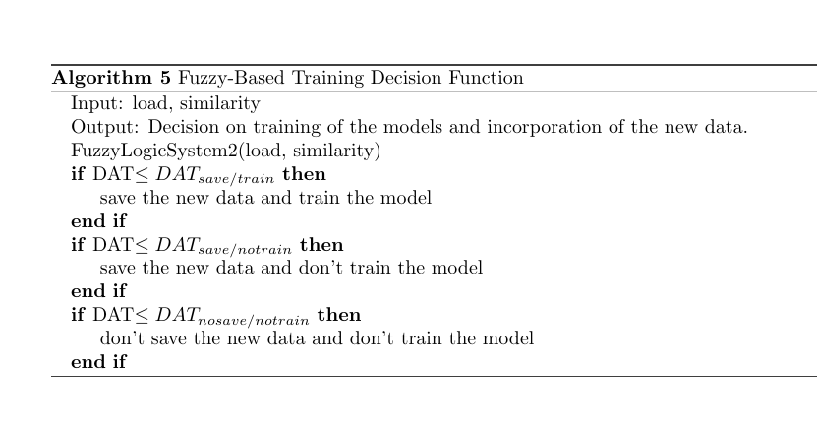
System Architecture / Algorithm

Slide 42
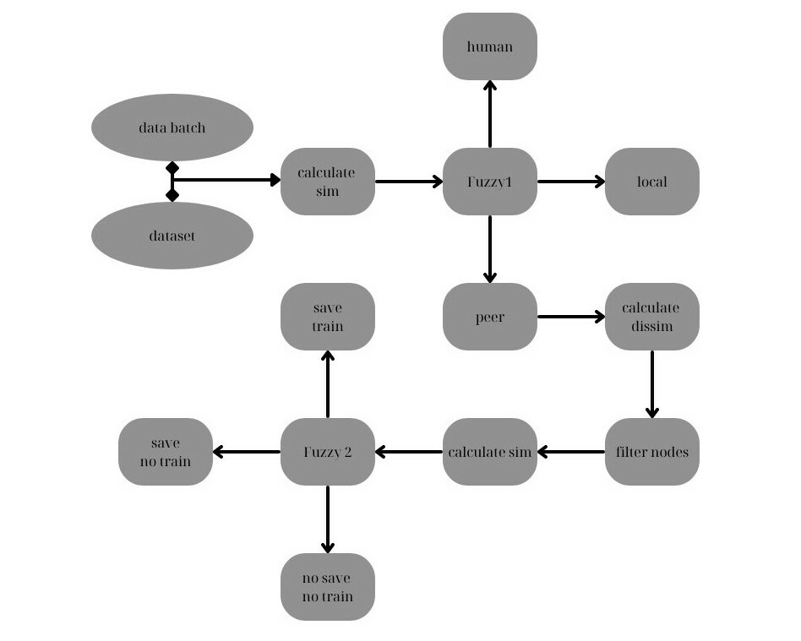
System Architecture / Algorithm

Slide 43
Experimental Setup
Tested on:
  Logistic Regression, SVR models
Datasets:
  D1: Synthetic data ( 6 input features, 1 binary output)
  D2: real building measurements (CO₂, temperature, humidity, occupancy across multiple rooms)
Metrics:
  pla: labeling accuracy (%)
  pcs: cost savings (%)
  pls: load savings (%)
  Precision, Recall, F1-score (%)
  RMSE, MAE
Compared with:
  Compared with DITL (direct TL) & DBO (occupancy method)

Slide 44
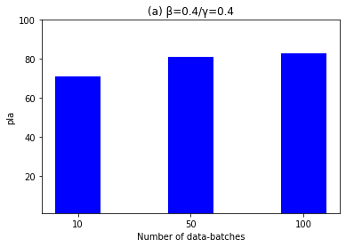
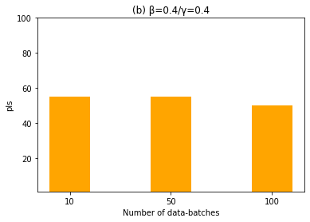
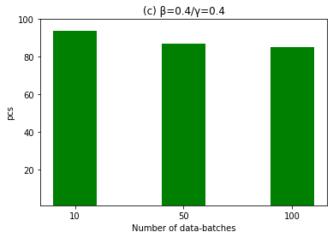
Results
Assessment of pla, pcs, pls (β = 0.4,γ = 0.4)

Slide 45
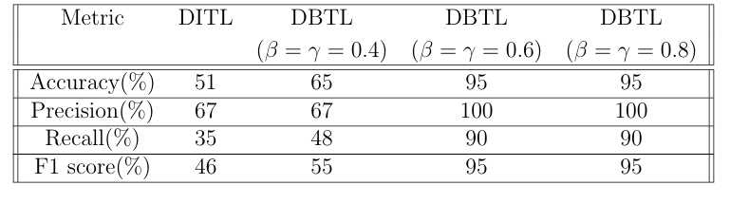
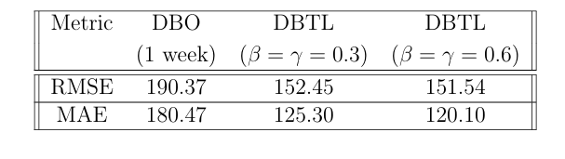
Results
Evaluation of DITL and DBTL across different β,γ threshold values
Evaluation of DBO and DBTL across different β,γ thresh old values

Slide 46
Results
Across all scenarios, pla between 71% and 95%, pcs between 85% and 94% and pls between 50% and 57%
Classification Performance:
  DBTL consistently outperforms DITL, achieving accuracy up to 95%, Precision 100%, Recall 90%, and F1-score 95% at higher β and γ values
  Significant gains in Recall (+55%) and F1-score (+49%) over DITL
Regression Performance:
  DBTL achieves lower errors than DBO, with RMSE reduced from 190.37 to 151.54 and MAE reduced from 180.47 to 120.10
  Improvements are consistent across tested β and γ values
Key takeaway:
DBTL yields substantial performance improvements over baseline approaches, maintaining robustness across different metrics

Slide 47
Discussion
Contributions:
  Introduced a lightweight and uncertainty-aware TL framework for edge nodes
  Enables adaptive labeling based on similarity and load/cost trade-offs
  Uses Z/F/K-S tests and fuzzy logic to support decision-making
  Achieves low-communication, high-efficiency model adaptation
  Suitable for real-time and dynamic edge environments
Future work:
  Enhance similarity measures using learned representations
  Extend framework to support continual learning and task heterogeneity

Slide 48
Task Management

Slide 49
Introduction
Task Management:
• Real-time applications run ML tasks across edge nodes
• Nodes may face data and concept drift over time
• Naive schedulers often fail under dynamic workloads
• Inaccurate predictions if drift is not handled
• Node overload leads to dropped tasks or poor performance
Motivation:
• Combine drift detection with load-aware offloading
• Use distribution similarity to choose where to offload tasks

Slide 50
Related Work
Existing Work:
• Static and dynamic management: FCFS, LJF, ILP-based heuristics, MAX-MIN concurrent execution
• Offloading: resource-driven, caching, multi-agent coordination
Gaps Identified:
• Ignore data and concept drift during scheduling
• No mechanism combines accuracy and system load
• Offloading decisions not guided by similarity
• Lack of joint drift and overload handling

Slide 51
Problem Statement
Goal:
• Enable edge nodes to dynamically adapt task execution under data evolution
• Prevent overload and accuracy degradation by offloading tasks when needed
Method:
• Detect data and concept drift using lightweight statistical checks
• Evaluate similarity between node datasets’ distributions
• Offload tasks to similar peers only when
– drift is detected and
– node is overloaded
Objectives:
• Maintain model accuracy and node responsiveness
• Avoid unnecessary retraining/offloading
• Use local data summaries to make decisions
• Find peers with similar distributions for offloading

Slide 52

Methodology
Drift Monitoring: $m_{ij}=\left(m_{ij_{1}},m_{ij_{2}},…,m_{ij_{d}}\right), v_{ij}=\left(v_{ij_{1}},v_{ij_{2}},…,v_{ij_{d}}\right)$
• Data Drift (sliding window):
    $μ_{base_{l}}=\frac{\sum_{j=1}^{W}{m_{ij_{l}}}}{W},v_{base_{l}}=\frac{\sum_{j=1}^{W}{v_{ij_{l}}}}{W}$
    $μ_{new_{l}}=\frac{\sum_{j=k−W+1}^{k}{m_{ij_{l}}}}{W},v_{new_{l}}=\frac{\sum_{j=k−W+1}^{k}{v_{ij_{l}}}}{W}$
    $\frac{\sum_{l=1}^{d}{I\left(\left|μ_{new_{l}}−μ_{base_{l}} \right|≥ Δ_{μ }∨ \left|v_{new_{l}}−v_{base_{l}}\right| ≥{ Δ}_{σ^{2}}\right)}}{d}≥α$
• Concept Drift (Exponentially Weighted Moving Average) :
    $EWMA\left(i,j\right)=λ⋅pm_{ij}+\left(1−λ\right)⋅EWMA\left(i,j−1\right)$
    $Var\left(i,j\right)=λ⋅{\left(pm_{ij}−EWMA\left(i,j\right)\right)}^{2}+\left(1−λ\right)⋅Var\left(i,j−1\right)$
    $ucl\left(i,j\right)=EWMA\left(i,1\right)+δ⋅\sqrt{Var\left(i,j\right)}$ /$lcl\left(i,j\right)=EWMA\left(i,1\right)−δ⋅\sqrt{Var\left(i,j\right)}$
    $EWMA\left(i,j\right)>ucl\left(i,j\right)∨EWMA\left(i,j\right)<lcl\left(i,j\right)$

Slide 53

Methodology
Computational load and task assignment:
  $ld_{i}=\frac{nts_{i}}{P_{i}}$
  $\frac{nts_{i}+sz_{s}}{P_{i}}≤ζ$
Similarity for offloading:
  Please refer to slide number 36
Thersholds:
  Load: ζ
  Data drift: α
  Concept drift: ucl, lcl

Slide 54
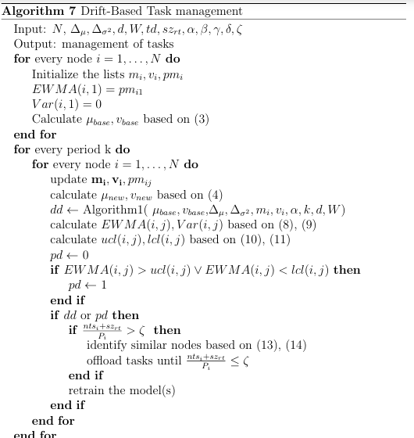
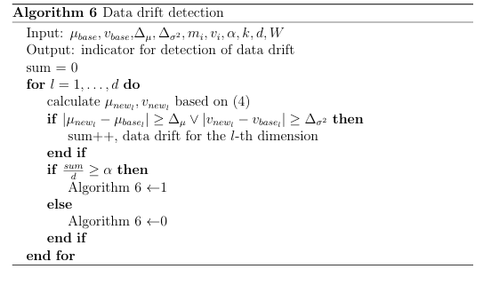
System Architecture / Algorithm

Slide 55
Experimental Setup
Tested on:
• D1: synthetic (3 features, 1 binary output)
• D2: Electricity pricing dataset (5 features, 1 binary output)
• Drift injected periodically (data and concept)
• Model: Support Vector Classification (SVC)
Metrics:
• MAE: prediction accuracy
• Load: average load across nodes
Compared with:
• FCFS: First Come First Served
• LJF: Longest Job First

Slide 56
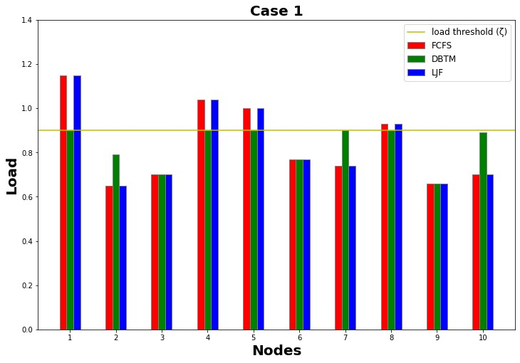
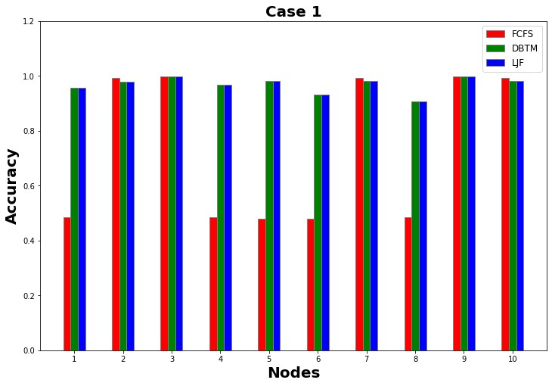
Results
Load and accuracy comparisons

Slide 57
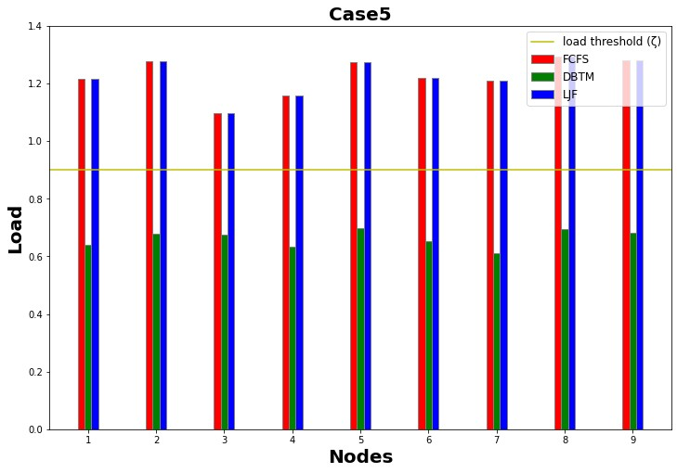
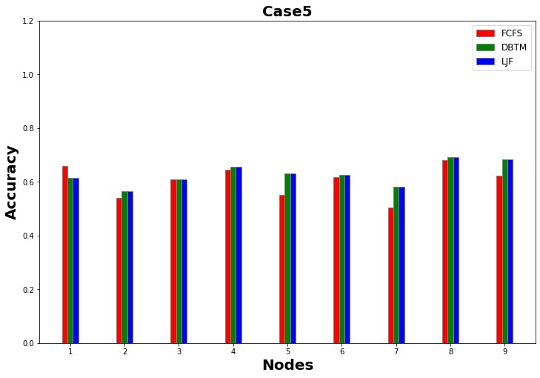
Results
Load and accuracy comparisons

Slide 58
Results
Case 1 (D1):
  DBTM keeps all nodes below ζ threshold, while FCFS and LJF often exceed it
  Accuracy between 0.95–1.0 for DBTM and LJF, while as low as 0.48 for FCFS
Case 5 (D2):
  FCFS/LJF consistently overload nodes , while DBTM maintains balance
  Comparable accuracy across all methods
Key takeaway:
  DBTM maintains system stability (load < ζ) while preserving accuracy
  Outperforms FCFS/LJF, especially under stressful workload conditions.

Slide 59
Discussion
Contributions:
  Introduced a drift-aware task management method that monitors data and concept drift
  Resilient against evolving data distributions
  Balances model accuracy and system load in dynamic edge environments
  Enables intelligent offloading decisions without centralized coordination
Future work:
  Extend DBTM to multi-task edge nodes
  Add adaptive drift thresholds based on real-time context
  Integrate with RL or heuristic optimizers for task-node matching

Slide 60
Task Scheduling

Slide 61
Introduction
Task scheduling:
  Tasks often have specific dataset requirements (mean, variance, value ranges for features)
  Many tasks share requirements but are scheduled independently, wasting computation
  Naive schedulers ignore key inter-task relationships (e.g., correlation).
  Load balancing without correlation awareness leads to degraded performance
Motivation:
  Exploit task requirements correlations to improve co-placement
  Formulate scheduling as an optimization problem that accounts for correlation and constraints
  Group tasks with similar data requirements for efficient resource reuse
  Minimize task failures while maximizing resource utilization through intelligent correlation-based scheduling

Slide 62
Related Work
Existing Work:
  Heuristic schedulers (e.g., FCFS, Round Robin) used in edge environments
  Graph-based methods optimize task placement via DAG analysis
  Some works minimize latency or resource usage
Gaps Identified:
  Lack of correlation-awareness: Existing approaches treat tasks independently
  Suitability checks incomplete or missing
  No joint consideration of task correlation and resource availability
  Suboptimal placements: Ignoring task correlation leads to higher latency and poor cache/memory reuse
  Current methods focus on system characteristics (load balance, completion time)

Slide 63
Problem Statement
Goal:
  Efficiently schedule correlated tasks across edge nodes
  Minimize task failures and improve efficiency by placing tasks only on suitable nodes and grouping correlated tasks
  Optimize task execution latency and resource utilization
  Need requirement-driven, correlation-aware scheduler
Method:
  Extract correlations via feature overlap analysis
  Schedule related tasks close together to enable reuse (cache/memory/local models)
  Consider node load and availability
Objectives:
  Minimize task failures and maximize resource utilization
  Reduce inter-node communication via smart grouping
  Maintain scalability and lightweight overhead for edge settings

Slide 64
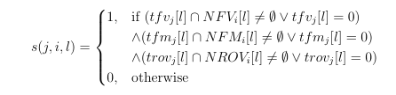


Methodology
Node statistical features:
  $NFV_{i}=\left[NFV_{i}\left[1\right],NFV_{i}\left[2\right],…,NFV_{i}\left[d\right]\right]$
  $NFM_{i}=\left[NFM_{i}\left[1\right],NFM_{i}\left[2\right],…,NFM_{i}\left[d\right]\right]$
  $NROV_{i}=\left[NROV_{i}\left[1\right],NROV_{i}\left[2\right],…,NROV_{i}\left[d\right]\right]$
Task requirements:
  $tfv_{j}=\left[tfv_{j}\left[1\right],tfv_{j}\left[2\right],…,tfv_{j}\left[d\right]\right]$
  $tfm_{j}=\left[tfm_{j}\left[1\right],tfm_{j}\left[2\right],…,tfm_{j}\left[d\right]\right]$
  $trov_{j}=\left[trov_{j}\left[1\right],trov_{j}\left[2\right],…,trov_{j}\left[d\right]\right]$
Node suitability:

Slide 65

Methodology
Node statistical features:
  $NFV_{i}\left[l\right]∼𝒩\left(μ_{1}i\left[l\right],σ_{1}i{\left[l\right]}^{2}\right), NFM_{i}\left[l\right]∼𝒩\left(μ_{2}i\left[l\right],σ_{2}i{\left[l\right]}^{2}\right)$
  $NROV_{i}\left[l\right]\left[1\right]∼𝒩\left(μ_{3}i\left[l\right],σ_{3}i{\left[l\right]}^{2}\right), NROV_{i}\left[l\right]\left[2\right]∼𝒩\left(μ_{4}i\left[l\right],σ_{4}i{\left[l\right]}^{2}\right)$
Expected suitability:
  $E(s(j,i,l)) = P[tfv_j[l] ∩NFV_i[l] ≠∅∨tfv_j[l] = 0] ⋅P[tfm_j[l] ∩NFM_i[l] ≠∅∨tfm_j[l] = 0] ⋅P[trov_j[l] ∩NROV_i[l] ≠∅∨trov_j[l] = 0]$
  $E\left(su_{j}\left[i\right]\right)=\prod_{l=1}^{d}{E\left(s\left(j,i,l\right)\right)}$
Overlap:
  $int_{1}=\left[a,b\right], int_{2}=\left[c,d\right]$
  $ov\left(int_{1},int_{2}\right)=\frac{\max\left(0,\min\left(b,d\right)−\max\left(a,c\right)\right)}{b−a}$
Correlation:
  $corr\left(v_{q},v_{w}\right)=\frac{\sum_{l=1}^{d}{\frac{ov\left(vq_{l},vw_{l}\right)+ov\left(vw_{l},vq_{l}\right)}{2}}}{d}$
  $corr\left(tfv_{q},tfv_{w}\right)≥θ∧corr\left(tfm_{q},tfm_{w}\right)≥θ∧corr\left(trov_{q},trov_{w}\right)≥θ$
Notes:
Federated Learning περιορισμένη πρόσβαση
Πιθανότητες υπολογίζονται μέσω CDF κανονικής κατανομής
Μείωση disk accesses
Επαναχρησιμοποίηση αποτελεσμάτων

Slide 66
Methodology
Thresholds:
  Suitability: γ
  Correlation: θ
  Load: β

Slide 67
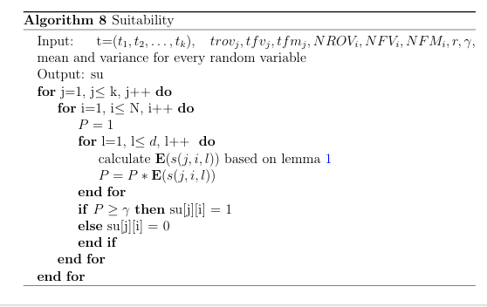
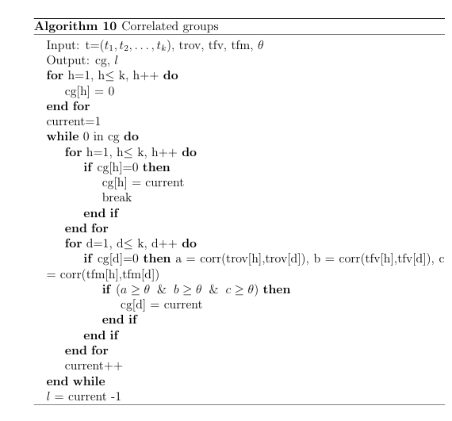
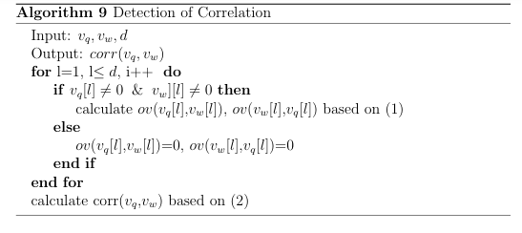
System Architecture / Algorithm

Slide 68
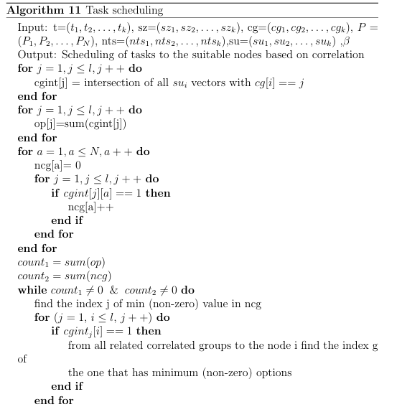
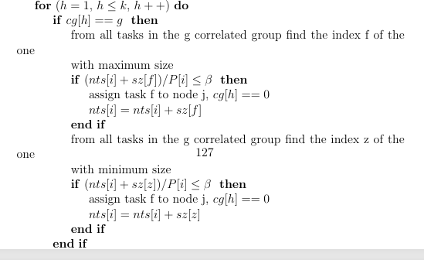
System Architecture / Algorithm

Slide 69
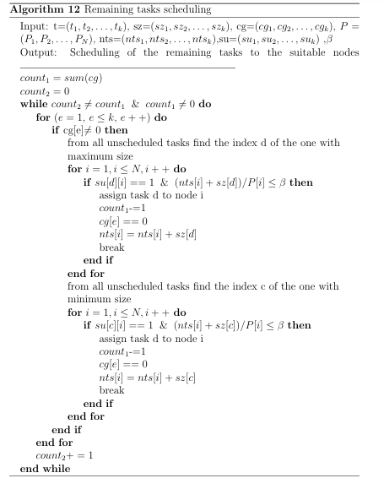
System Architecture / Algorithm

Slide 70
Experimental Setup
Tested on:
• D1: Synthetic dataset (3 features, task scheduling simulation)
• D2: Real Estate dataset (4 features used, task scheduling for ML regression)
• Tasks: 10, 50, 100 (injected with varying requirements)
Metrics:
• Percentage of Task Failures (ptf)
• Correlation-based Scheduling Percentage (pbc)
• System Load (load)
Compared with:
• FCFS: First Come First Served
• MAX-MIN scheduling
• SJF: Shortest Job First
• LJF: Longest Job First

Slide 71
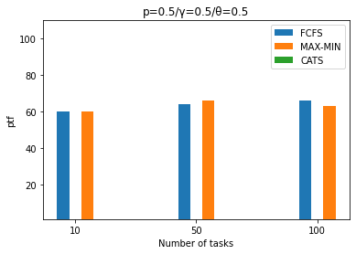
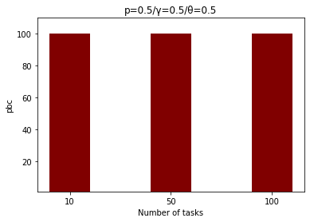
Results
Comparison of ptf and evaluation of pbc

Slide 72
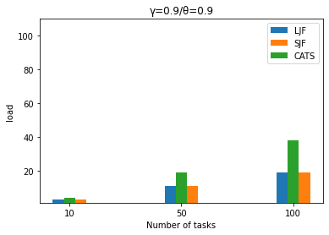
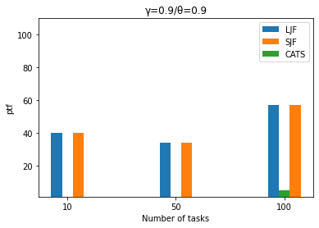
Results
Comparison of load and ptf

Slide 73
Results
pbc and ptf:
  CATS: ptf = 0%, pbc = 100%
  FCFS, MAX-MIN: ptf >= 60%
load and ptf:
  CATS: increased load utilization, ptf <5%.
  LJF and SJF: decreased load utilization, ptf >30–40%
Key takeaway:
  CATS showcases scalability as number of tasks increases
  Outperforms LJF, SJF in both resiliency and efficiency

Slide 74
Discussion
Contributions:
  correlation-aware task scheduling framework that optimizes scheduling decisions by considering correlations among tasks
  mechanism maximizes resource utilization while at the same time minimizes task failures
  task requirements taken into consideration in order to provide efficient task scheduling
Future work:
  Support dependencies and priorities
  ML-specific task scheduling

Slide 75
Publications
‘Cluster based similarity extraction upon distributed datasets’, Cluster Computing, Springer
‘Data and resource aware incremental ML training in support of pervasive applications’, Computing, Springer
‘Homogeneous transfer learning for supporting pervasive edge applications’, Evolving Systems, Springer
‘Drift-based task management in support of pervasive edge applications’, Internet of Things, Elsevier
‘Correlation adaptive task scheduling’, Computing, Springer

Slide 76
THANK YOU FOR YOUR ATTENTION!
ANY QUESTIONS?

